Slide 1
Meeting Summary
Introduction & Welcome
Applying psychological theory to driver retention
Variable Analysis and Results
Key Focus Items
Action Item Review
Conclusion

Slide 2
Driver Retention & Turnover
Clara Min, Jill Cox, Vanessa Lee

Slide 3
Turnover – Historical Efforts
Pay Additions
Minimum Pay Programs
Bonuses
Home-Time
Teaming Tool
Operations Re-Organization
Training Videos
Progress?

Slide 4
Model Strategy

Slide 5
HOS
HOS
HOS
Wage
Wage
Wage
Detention
Detention
Detention
Teaming
Teaming
Pay Expectations
Teaming
Pay Expectations
Home Time
Home Time
Lay-Over

Slide 6
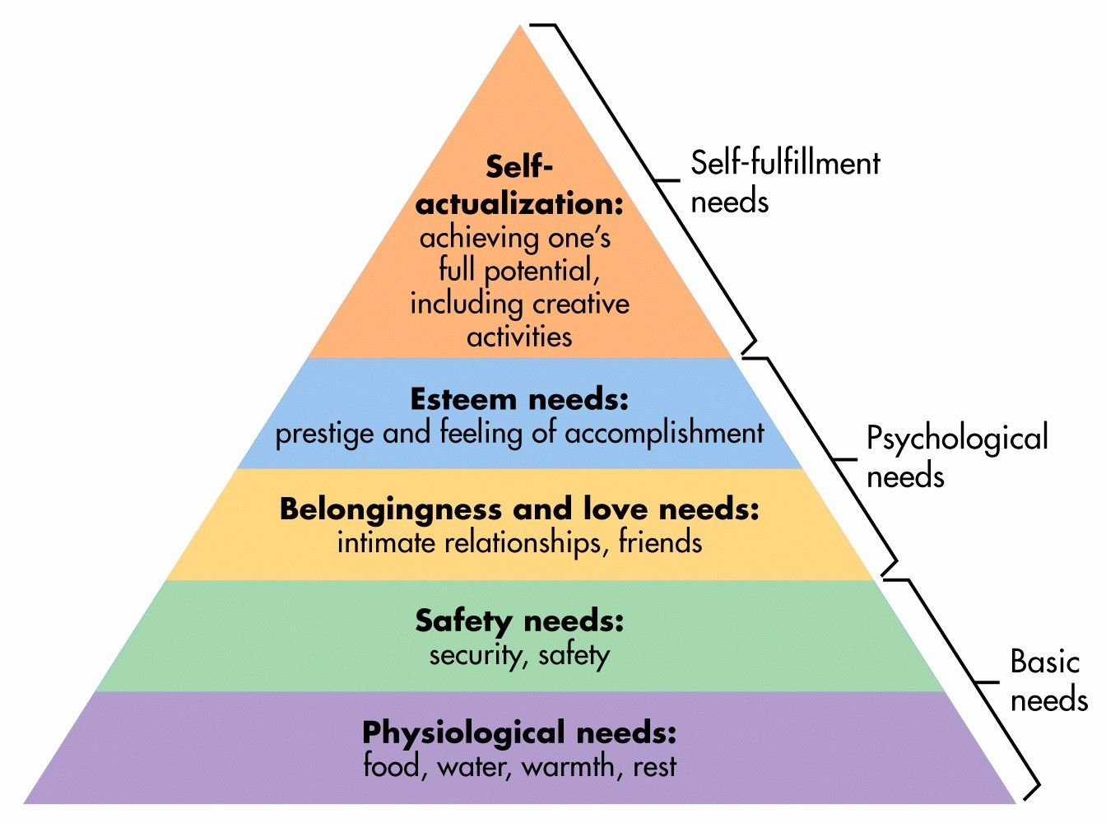
Model Strategy = Maslow's Hierarchy of Needs

Slide 7
Are we meeting the basic needs?
Safety & Security Needs:
Employment
Financial Security
Property
Protection & Law
Wages
Pay Expectations
Pay Complexity
DOT
Insecurities?
Physiological Needs:
Sleep
Food
Water
Oxygen
Could any existing business process compromise the basic needs?

Slide 8
Are psychological needs being met?
Social Needs:
Friendships
Family
Romantic attachments
Social groups
Churches and religious organizations
Team Mate
Home-time
Do we respect professional drivers time?
Esteem Needs:
Respect
Self-Esteem
Appreciation
Prestige
Recognition
Detention
Lay-over
Notes:
When basic needs are met, esteem and social needs become more important.

Slide 9
Are we helping our professional drivers reach their full potential?
Accomplishment
Career Paths
Career Advancement
Notes:
– 83% of drivers indicated that career advancement was “somewhat” to “very important”
– 54% of drivers perceived opportunities of advancement in their company was “poor” or “very poor.”
– “A large majority of drivers prefer some form of advancement as a driver as opposed to moving to a different job in the company. As a result, it is probable that a lack of a career path encourages drivers to think about quitting and/or searching for a different job”

Slide 10
Theory in Action

Slide 11
Who is leaving?
Driver Type | Total | Left | left %
Student | 837 | 433 | 51.7%
OO | 214 | 28 | 13.1%
DRVENG | 52 | 10 | 19.2%
OTR | 2449 | 924 | 37.7%
Trainer | 156 | 20 | 12.8%

Slide 12
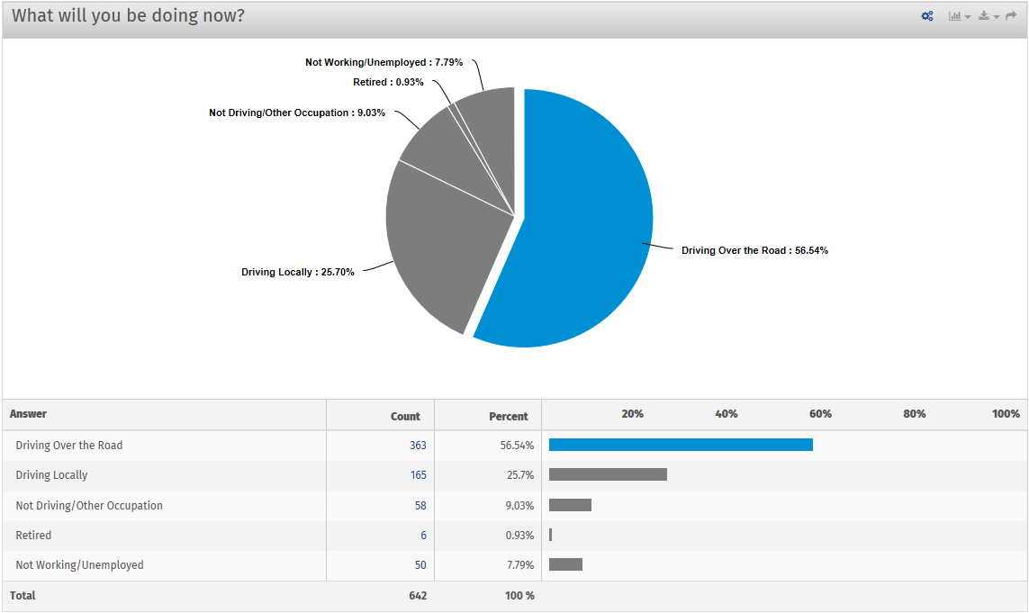
Where are they going?

Slide 13
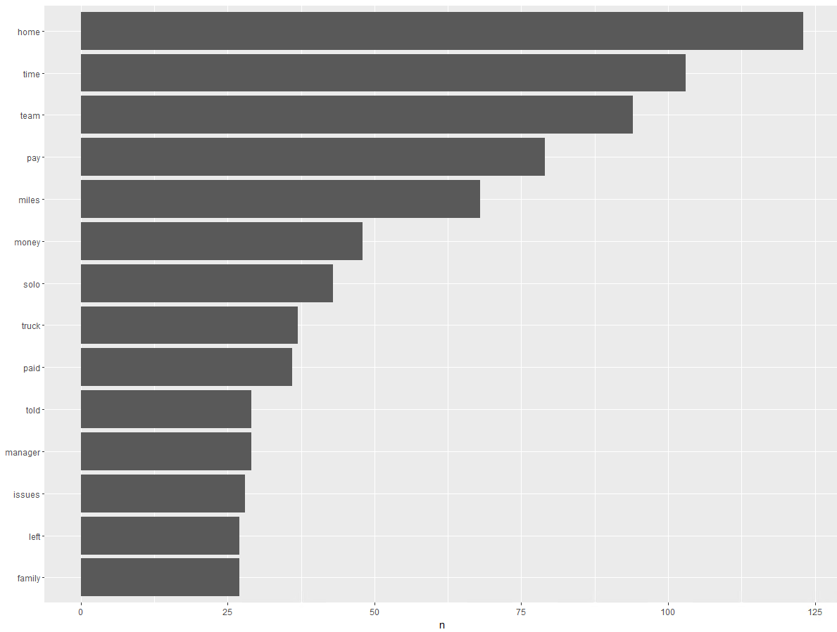
Why are they leaving?

Slide 14
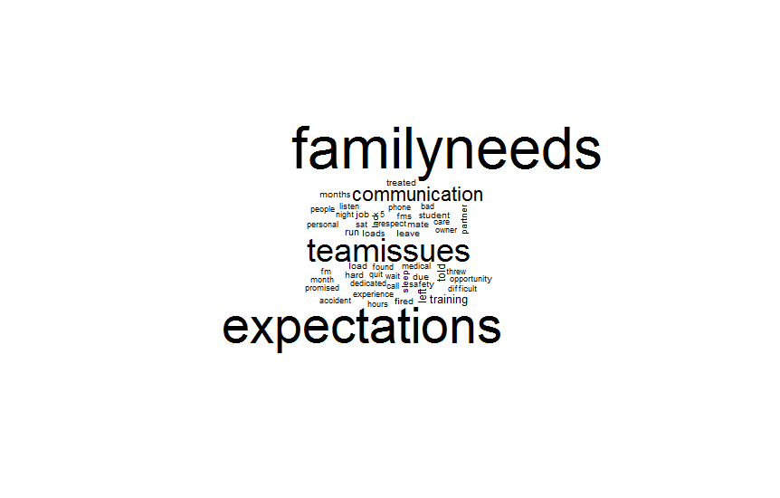
Why are they leaving?

Slide 15
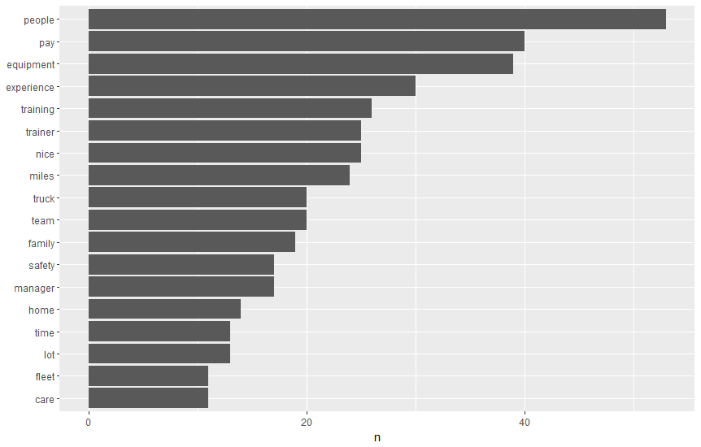
What do people like about Covenant?

Slide 16
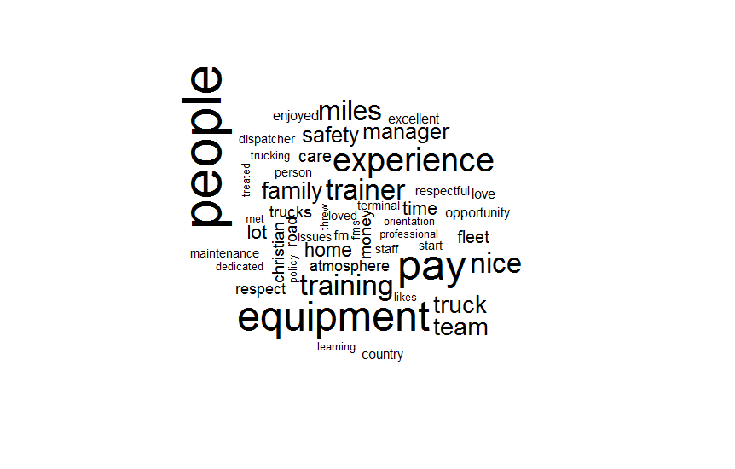
What do people like about Covenant?

Slide 17
What are the reasons they left?

Slide 18
Are the issues distributed evenly among tenure?

Slide 19
Financial Security
 | LEFT | STAYED | DIFFERENCE
DRVENG | $1,207.01 | $1,112.07 | $94.94
OTR | $909.40 | $947.89 | -$38.49
OO | $1,020.47 | $1,011.42 | $9.05
TD/ST | $716.43 | $735.80 | -$19.36
Trainer | $963.23 | $1,064.29 | -$101.06

Slide 20
Financial Security
Currently there are processes to prevent overpaying drivers but not underpaying
Notes:
Certain paycodes can also be an indicator that pro drivers understand how to put in for pay that they are owed
Ex: 95.5% of the time drivers get home when requested. Of the 4.5% that are late and qualify for late home pay 21% don’t ask for it
Currently there are reports and processes in place to ensure drivers aren’t overpaid, but nothing to ensure not underpaid. Ex: ETOExpirations for Late hometime pay
This is verified by David Mathis, Taylor Bryant, and Sarah Arnold, Paul Allen, and Holly Thomas (payroll)
Make some sort of flow chart to show operations process to ensure dirvers aren’t over paid compared to underpaid
OTR that leave are twice as likely as OTR that stay to have corrections to their pay. 0.16 compared to 0.8 respectively.
Add in statistics about layover pay when data is collected.
In later sections we will look at the effects of Detention pay, layover pay, and late home pay

Slide 21
Social Needs: Team Partner
$244 <6months
$460 >2 years
Notes:
Those who leave are more likely to have more team partners compared to their counterparts.
It will decrease the next paycheck after reteaming by $244 on average for a OTR driver who has been with the company for less than 6 months. This number goes up to $460 for a driver who has been with the company for over 2 years.
The difference in the cost of teaming is likely due to the selectivity of those who have been around for 2 years. They are likely to ask more questions such as do you drive at night? How long of shifts do you like?
(it would be great if we could visualize this with a filled up dollar sign)
The cost of teaming varies by how many days of driving are lost and how long it takes to get both members in the same location. This can take anywhere from 1day to 3 weeks with most falling in the 2-4 day time window. Within the 2-4 day window

Slide 22
Social Needs: Home-time

Slide 23
Esteem Needs: Need to keep moving

Slide 24
Esteem Needs: Need to keep moving

Slide 25
Esteem Needs: Need to keep moving

Slide 26
Esteem Needs: Need to keep moving
Things that caused a layover not to be considered:
Non-Paid: being in the shop, Earned Time Off, Family Medical Leave, Sent Home, Military Leave, Terminated, Personal Leave, Route Through Home, Route to Terminal, Sick
Paid: Student Upgrade, Safety Review, Pickup student

Slide 27
Time Utilization

Slide 28
Time Utilization

Slide 29
Top 7 Variables that Contributed to the Retention Model
1. Active driving days
2. Numbers of times reteamed
3. Was the safety bonus given
4. Seniority
5. Active driving time per day
6. How many details were in pay
7. Driver type (Career advancement)
Future Variable to Consider
Sentiment change in Qualcomm messages
Changes in driver utilization as opportunities to coach

Slide 30
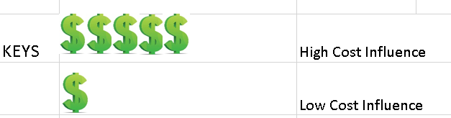
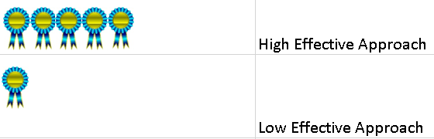

Legend:

Slide 31
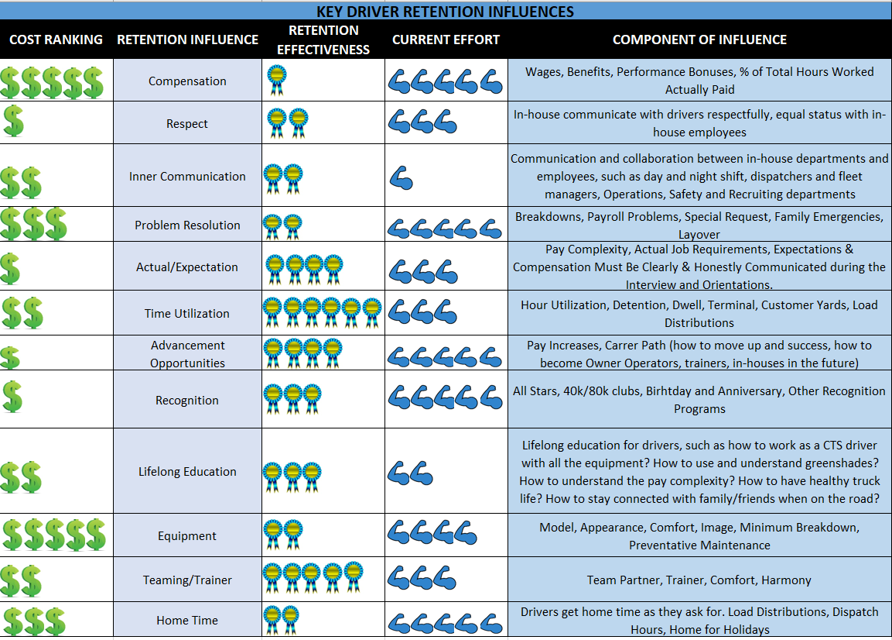




Slide 32
Special Thanks to:
Sarah Arnold
David Mathis
Patrick Hamilton
Debbie Henderson-Bell
Holly Thomas
Paul Allen
Susan Bowman
Sam Tibbs
Safety and Recruiting

